Slide 1
CSE-319 Software Engineering
By
Rubyeat Islam
sites.google.com/site/islamrubyeat

Slide 2
Objectives
To introduce architectural design and to discuss its importance
To explain why multiple models are required to document a software architecture
To describe types of architectural model that may be used
To discuss how domain-specific reference models may be used as a basis for product-lines and to compare software architectures

Slide 3
Topics covered
System structuring
Control models
Modular decomposition
Domain-specific architectures

Slide 4
Software architecture
The design process for identifying the sub-systems making up a system and the framework for sub-system control and communication is architectural design
The output of this design process is a description of the software architecture

Slide 5
Architectural design
An early stage of the system design process
Represents the link between specification and design processes
Often carried out in parallel with some specification activities
It involves identifying major system components and their communications

Slide 6
Advantages of explicit architecture
Stakeholder communication
Architecture may be used as a focus of discussion by system stakeholders
System analysis
Means that analysis of whether the system can meet its non-functional requirements is possible
Large-scale reuse
The architecture may be reusable across a range of systems

Slide 7
Architectural design process
System structuring
The system is decomposed into several principal sub-systems and communications between these sub-systems are identified
Control modelling
A model of the control relationships between the different parts of the system is established
Modular decomposition
The identified sub-systems are decomposed into modules

Slide 8
Sub-systems and modules
A sub-system is a system in its own right whose operation is independent of the services provided by other sub-systems.
A module is a system component that provides services to other components but would not normally be considered as a separate system

Slide 9
Architectural models
Different architectural models may be produced during the design process
Each model presents different perspectives on the architecture

Slide 10
Architectural models
Static structural model that shows the major system components
Dynamic process model that shows the process structure of the system
Interface model that defines sub-system interfaces
Relationships model such as a data-flow model

Slide 11
A Taxonomy of Architectural Styles
Independent Components
Communicating
Processes
Event Systems
Implicit
Invocation
Explicit
Invocation
Client/Server
Peer-to-Peer
Data Flow
Data-Centered
Batch Sequential
Pipe and
Filter
Repository
Blackboard
Virtual Machine
Call and Return
Main Program
and Subroutine
Object
Oriented
Layered
Interpreter
Rule-Based
System
11
Remote Procedure Call

Slide 12
Architectural styles
The architectural model of a system may conform to a generic architectural model or style
An awareness of these styles can simplify the problem of defining system architectures
However, most large systems are heterogeneous and do not follow a single architectural style

Slide 13
Architecture attributes
Performance
Localise operations to minimise sub-system communication
Security
Use a layered architecture with critical assets in inner layers
Safety
Isolate safety-critical components
Availability
Include redundant components in the architecture
Maintainability
Use fine-grain, self-contained components

Slide 14
System structuring
Concerned with decomposing the system into interacting sub-systems
The architectural design is normally expressed as a block diagram presenting an overview of the system structure
More specific models showing how sub-systems share data, are distributed and interface with each other may also be developed

Slide 15
Packing robot control system

Slide 16
Client-server architecture
Distributed system model which shows how data and processing is distributed across a range of components
Set of stand-alone servers which provide specific services such as printing, data management, etc.
Set of clients which call on these services
Network which allows clients to access servers

Slide 17
Film and picture library

Slide 18
Client-server characteristics
Advantages
Distribution of data is straightforward
Makes effective use of networked systems. May require cheaper hardware
Easy to add new servers or upgrade existing servers
Disadvantages
No shared data model so sub-systems use different data organisation. data interchange may be inefficient
Redundant management in each server
No central register of names and services - it may be hard to find out what servers and services are available

Slide 19
Control models
Are concerned with the control flow between sub-systems. Distinct from the system decomposition model
Centralised control
One sub-system has overall responsibility for control and starts and stops other sub-systems
Event-based control
Each sub-system can respond to externally generated events from other sub-systems or the system’s environment

Slide 20
Centralised control
A control sub-system takes responsibility for managing the execution of other sub-systems
Call-return model
Top-down subroutine model where control starts at the top of a subroutine hierarchy and moves downwards. Applicable to sequential systems
Manager model
Applicable to concurrent systems. One system component controls the stopping, starting and coordination of other system processes. Can be implemented in sequential systems as a case statement

Slide 21
Call-return model

Slide 22
Event-driven systems
Driven by externally generated events where the timing of the event is outwith the control of the sub-systems which process the event
Two principal event-driven models
Broadcast models. An event is broadcast to all sub-systems. Any sub-system which can handle the event may do so
Interrupt-driven models. Used in real-time systems where interrupts are detected by an interrupt handler and passed to some other component for processing
Other event driven models include spreadsheets and production systems

Slide 23
Selective broadcasting

Slide 24
Modular decomposition
Another structural level where sub-systems are decomposed into modules
Two modular decomposition models covered
An object model where the system is decomposed into interacting objects
A data-flow model where the system is decomposed into functional modules which transform inputs to outputs. Also known as the pipeline model
If possible, decisions about concurrency should be delayed until modules are implemented

Slide 25
Object models
Structure the system into a set of loosely coupled objects with well-defined interfaces
Object-oriented decomposition is concerned with identifying object classes, their attributes and operations
When implemented, objects are created from these classes and some control model used to coordinate object operations

Slide 26
Data-flow models
Functional transformations process their inputs to produce outputs
May be referred to as a pipe and filter model (as in UNIX shell)
Variants of this approach are very common. When transformations are sequential, this is a batch sequential model which is extensively used in data processing systems
Not really suitable for interactive systems

Slide 27
Invoice processing system

Slide 28
OSI reference model
Application

Slide 29
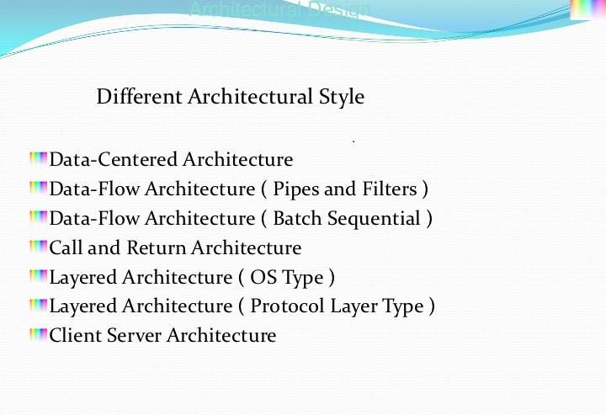

Slide 30
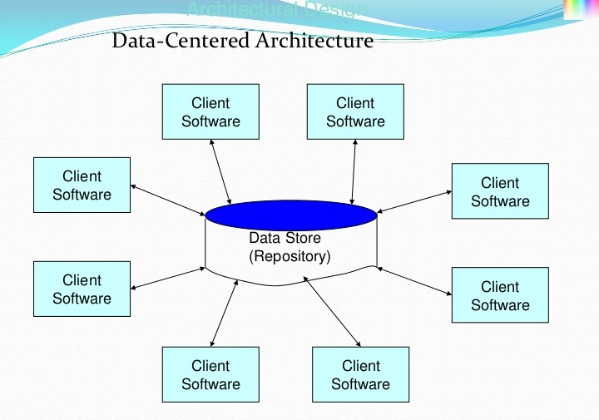

Slide 31
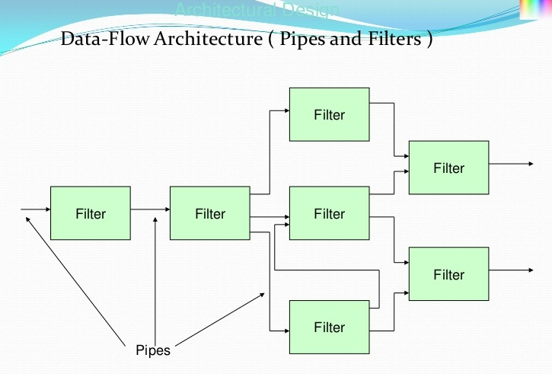

Slide 32
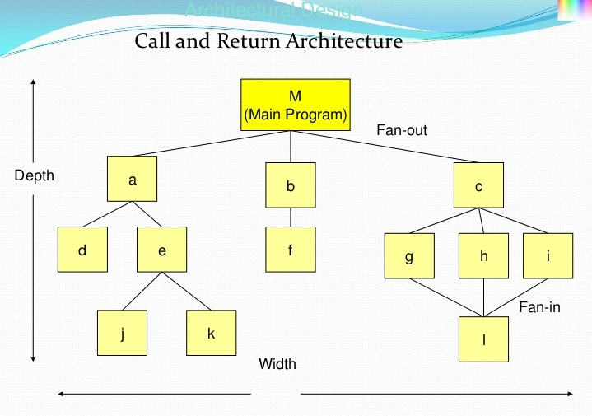

Slide 33
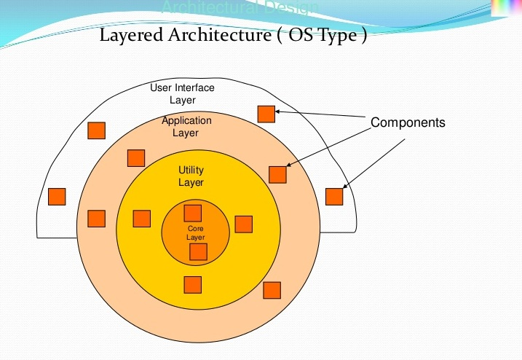

Slide 34
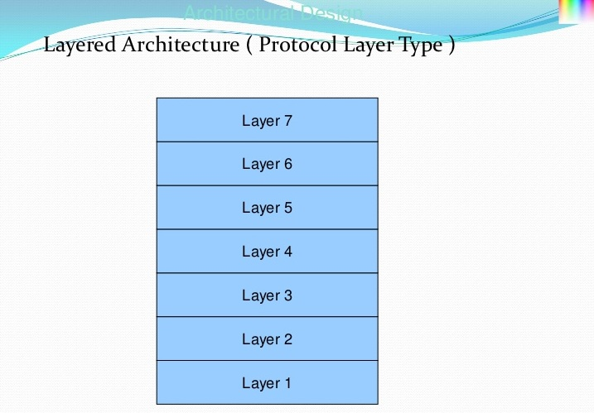

Slide 35
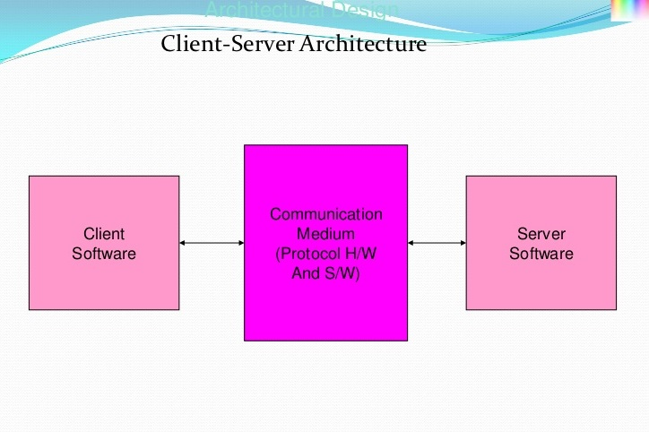

Slide 36
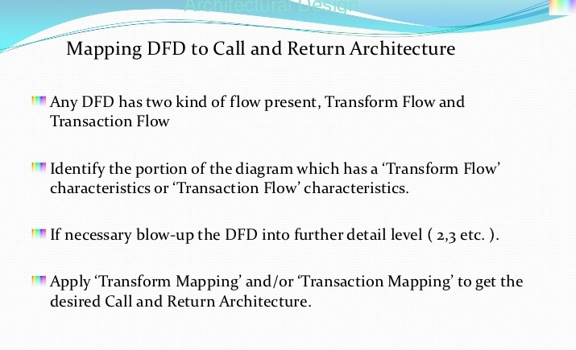

Slide 37
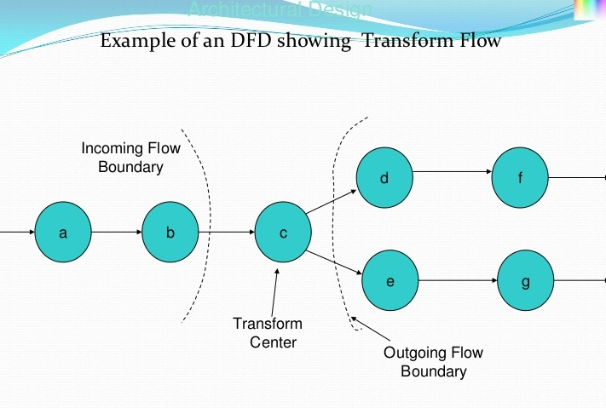

Slide 38
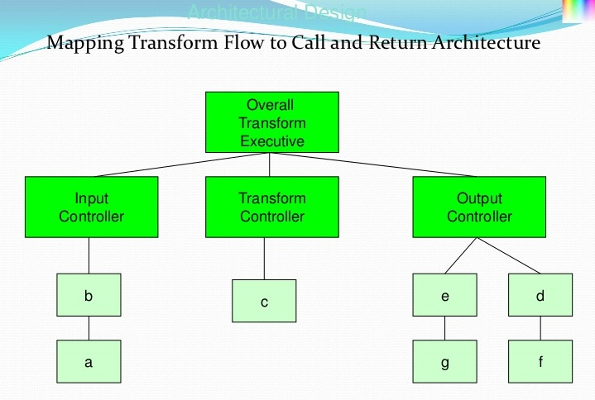

Slide 39
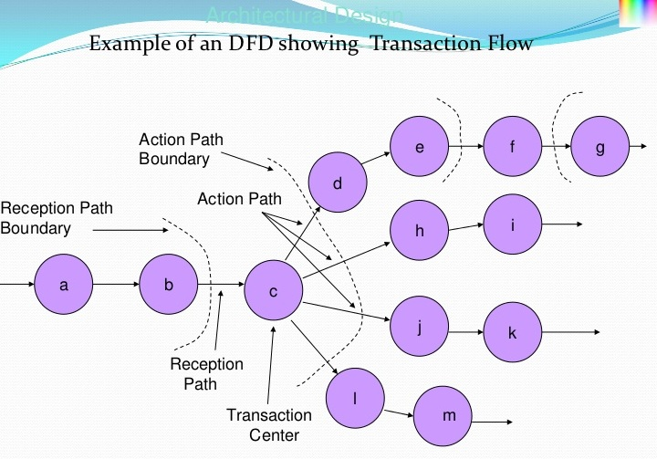

Slide 40
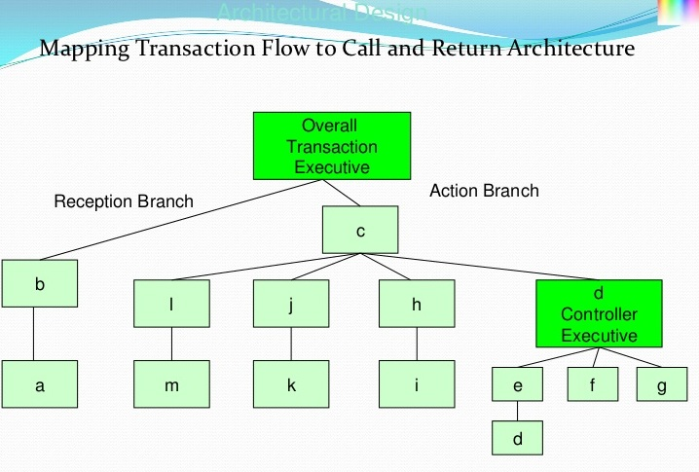

Slide 41
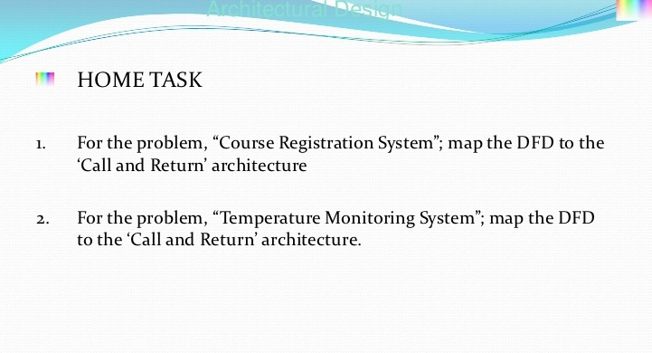

Slide 42
Key points
The software architect is responsible for deriving a structural system model, a control model and a sub-system decomposition model
Large systems rarely conform to a single architectural model
System decomposition models include repository models, client-server models and abstract machine models
Control models include centralised control and event-driven models

Slide 43
Key points
Modular decomposition models include data-flow and object models
Domain specific architectural models are abstractions over an application domain. They may be constructed by abstracting from existing systems or may be idealised reference models

